Slide 1

HealthSphere

Slide 2
Team
Anandita Maurya
Jheel Patel
Shahliza Arshad
Aditya Deshpande
Linh Nguyen

Slide 3

Introduction
Introducing HealthSphere, the innovative hospital management system that streamlines operations and enhances patient care. HealthSphere is a comprehensive platform that allows hospital administrators, healthcare providers, and patients to access and manage critical health data in real-time, resulting in improved efficiency, reduced costs, and enhanced patient outcomes.
For hospital administrators can manage their operations more efficiently, healthcare providers can streamline patient care delivery.
For healthcare providers, HealthSphere provides a streamlined workflow, allowing them to focus on patient care without worrying about administrative tasks.
For patients, they can access their medical records, schedule appointments, and communicate with their healthcare providers through a user-friendly portal, improving their overall experience and engagement with the hospital.
HealthSphere is unique because it will help the hospital send personalized texts/reminders to the patients to make sure they are following the doctor's care instructions
Overall, HealthSphere is a game-changer for hospitals looking to improve patient care, increase efficiency, and streamline operations. With HealthSphere, hospitals can provide the best possible care to their patients while maximizing operational efficiency and improving overall outcomes.

Slide 4

Motivators
What: The what motivator for our Hospital Management System is the need for an all-in-one platform to manage the operations and services of a hospital. The system can help hospitals streamline their operations, reduce errors, and improve patient care.
Why: The why motivator for our Hospital Management System is the need for greater efficiency and effectiveness in healthcare. Hospitals face increasing pressure to provide high-quality care while controlling costs, and a hospital management system can help them achieve these goals by streamlining operations and improving resource management.
Who: The who motivator for our Hospital Management System includes hospital administrators, staff, and patients. Hospital administrators and staff need a system that can help them manage operations efficiently and effectively. Patients need a system that can provide them with easy access to their medical records, appointment scheduling, and communication with healthcare providers.
How: The how motivator for our Hospital Management System involves the use of technology to improve healthcare delivery. The system utilizes various technologies such as electronic health records (EHRs), online appointment scheduling, and messaging systems to streamline communication and improve resource management. These technologies can help hospitals reduce costs, improve efficiency, and enhance the quality of care they provide.
This Photo by Unknown author is licensed under CC BY-ND.

Slide 5
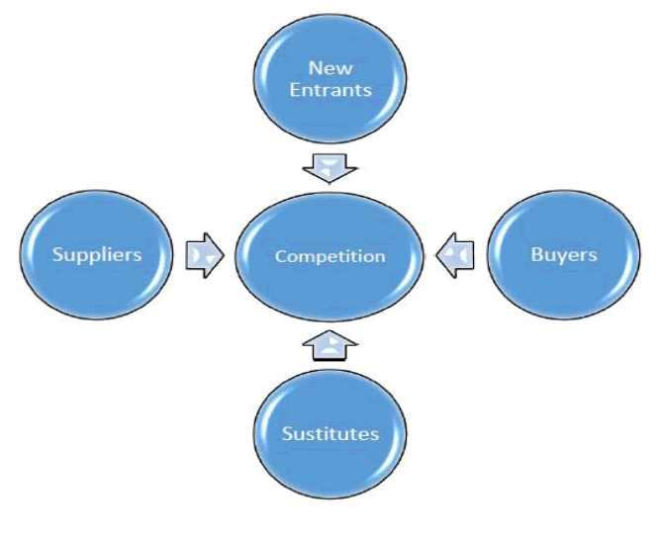
Porters Five forces
Threat of new entrants: The threat of new entrants is low since developing a hospital management system requires significant investment in technology and expertise. Additionally, there are already established players in the market, which would make it difficult for new entrants to gain market share.
Bargaining power of suppliers: The bargaining power of suppliers is low since there are many software development companies that can provide the necessary technology and support to develop a hospital management system.
Bargaining power of buyers: The bargaining power of buyers is high since there are many hospital management systems available in the market. Buyers can easily compare features and pricing, and switch to a different system if they are not satisfied with the current one.
Threat of substitutes: The threat of substitutes is low since there are few alternatives to hospital management systems. Hospitals require a system to manage their operations, and manual methods would be less efficient and more prone to errors.
Rivalry among existing competitors: The rivalry among existing competitors is high since there are many established players in the market. Each company competes on features, pricing, and customer support to differentiate itself from others.
This Photo by Unknown author is licensed under CC BY.

Slide 6
Core competencies
Telehealth, telemedicine and remote healthcare: Enable healthcare providers to deliver virtual consultations, remote monitoring, and other types of medical services remotely. This can help reduce the need for patients to visit the hospital in person.
SMS personalized reminders: Leverage text messaging or email. Patients can receive reminders in a format and frequency that is most convenient for them, such as daily, weekly, or monthly. Additionally, personalized reminders can be customized based on a patient's specific needs, such as language preferences, cultural considerations, and health conditions.
Linking government ID: Integrating government ID into our system can help healthcare providers verify patient identity quickly and accurately, reducing the risk of errors and improving patient safety. Additionally, it can also help prevent fraud and protect patient privacy by ensuring that only authorized individuals have access to medical records. Our system must ensure we comply with relevant laws and regulations, such as HIPAA, and implement appropriate safeguards to protect patient information.
Interoperability: In today's healthcare landscape, different systems and technologies need to work together seamlessly. Our product can integrate with other systems, such as electronic health records (EHRs) and telemedicine platforms, which can help hospitals provide better care and improve patient outcomes.
Security and privacy: Healthcare data is highly sensitive, so our product has robust security features to protect patient information. This includes features such as access controls, encryption, and audit trails.

Slide 7

Strategy and Technique of the Product
Involve Stakeholders – It is important to involve stakeholders of the healthcare management system such as patients, doctors, administration department, pharmacies etc. for better performance of the system.
Define objectives – Having a set objective helps to take each step in with a clear motive and reach the goal in a more efficient manner.
Continuous monitored improvement - Continuous improvement involves monitoring performance metrics, analyzing user feedback, and making updates and enhancements based on these insights

Slide 8
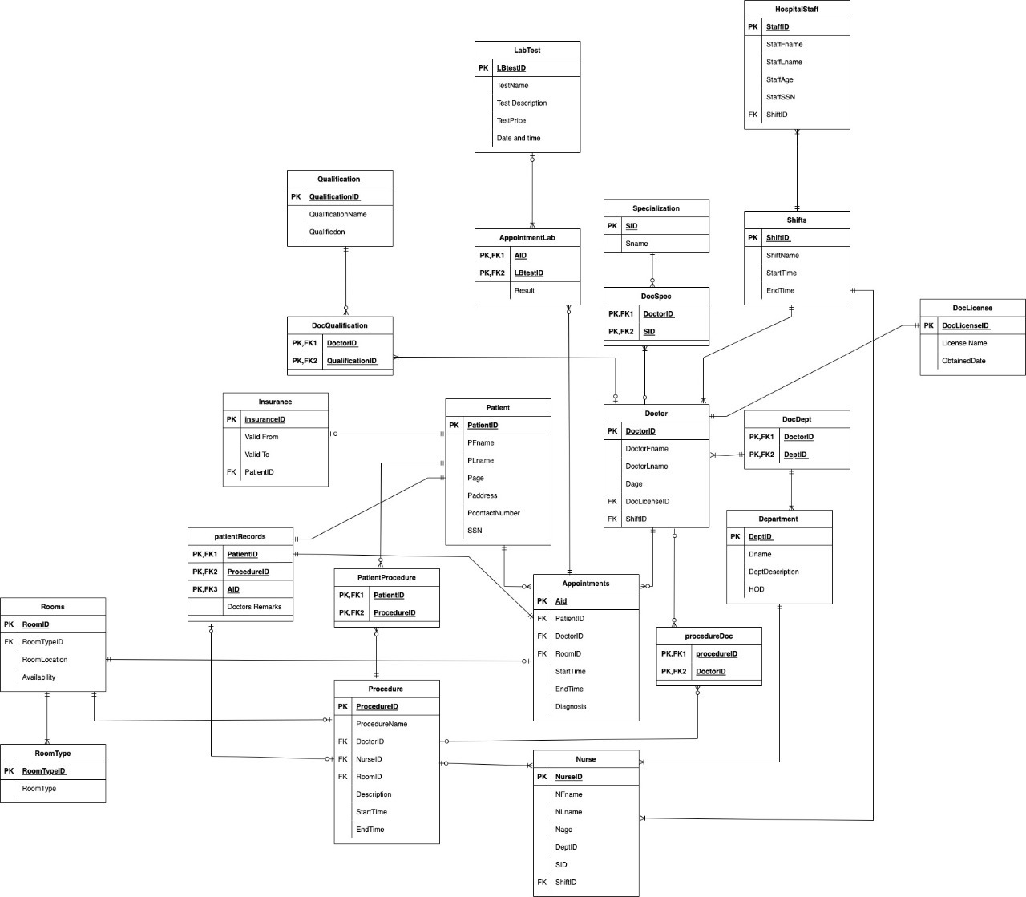

Slide 9
Entity Relationship
Patient and Doctor: We assume that a doctor can have many patients (1:M) (optional), and a patient can consult many doctors (1:M).As a result, the cardinality and constraints become (M Optional; N Optional).
Patient and Appointment: We assume that a patient has the ability to schedule multiple appointments (1:M) (Optional) but an appointment will be specific to a single patient (1:1) (mandatory), so together the cardinality and constraints become (M Optional: 1 Mandatory).
Patient and Insurance: We assume that a patient can have only one insurance or no insurance; hence, the cardinality and constraints are (1 mandatory and 1 optional).
Doctor and Shift: We assume that a doctor will have only one shift, and one shift can be applied to multiple doctors, so together the cardinality and constraints become (M mandatory: 1 mandatory).
Nurse and Shift: We assume that a nurse will have only one shift, and one shift can be applied to multiple nurses, so together the cardinality and constraints become (M mandatory: 1 mandatory).
Hospital staff and shift: We assume that a hospital staff will have only one shift, and one shift can be applied to multiple hospital staff, so together the cardinality and constraints become (M mandatory: 1 mandatory).
Doctor and Department: We assume that a doctor can be a part of multiple departments (1:M) (mandatory), and a department can have multiple doctors (1:M). As a result, the cardinality and constraints are (M required; N optional).

Slide 10
Normalization
We check the tables for multivalued attributes and identify the primary keys to bring it to 1NF.
Then we convert this table to 2NF by removing any partial functional dependencies.
We can convert the table to 3NF by removing any transitive dependencies.
We convert the table to BCNF by making every determinant a candidate key or multiple candidate keys where each key has only one attribute.
*We have created the ERD shown below after normalization.

Slide 11
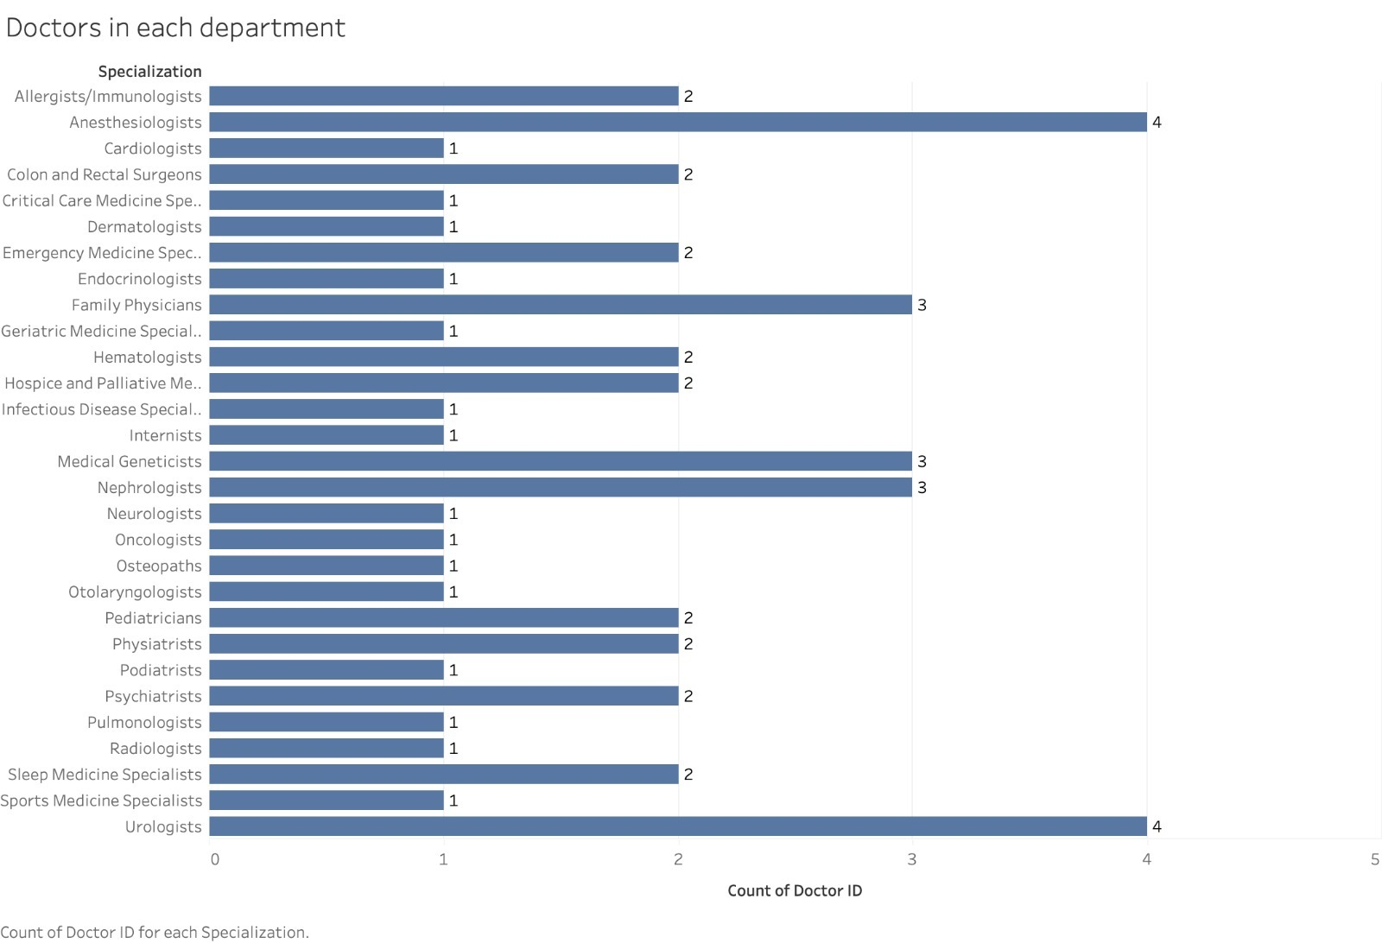
Data Visualization

Slide 12
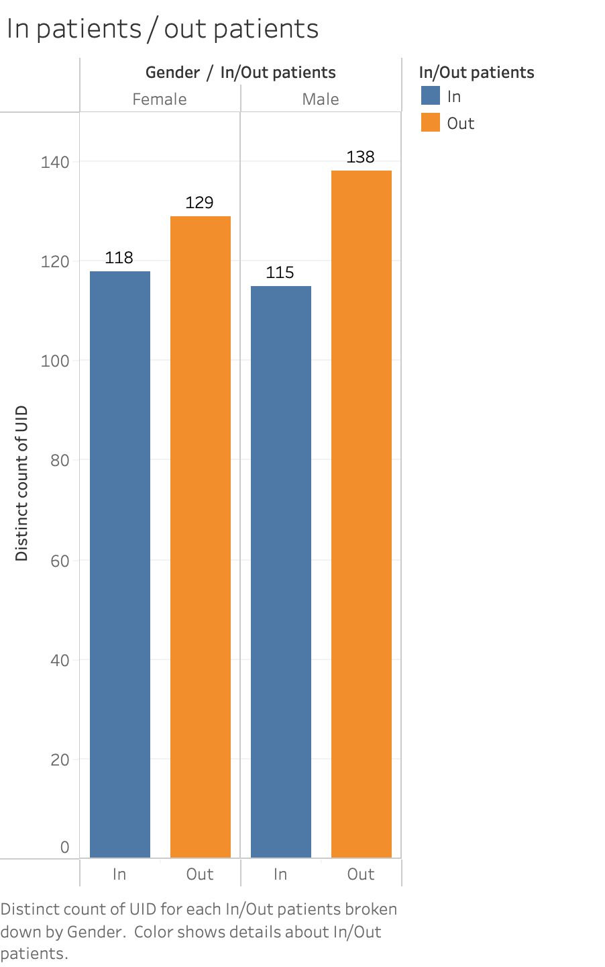
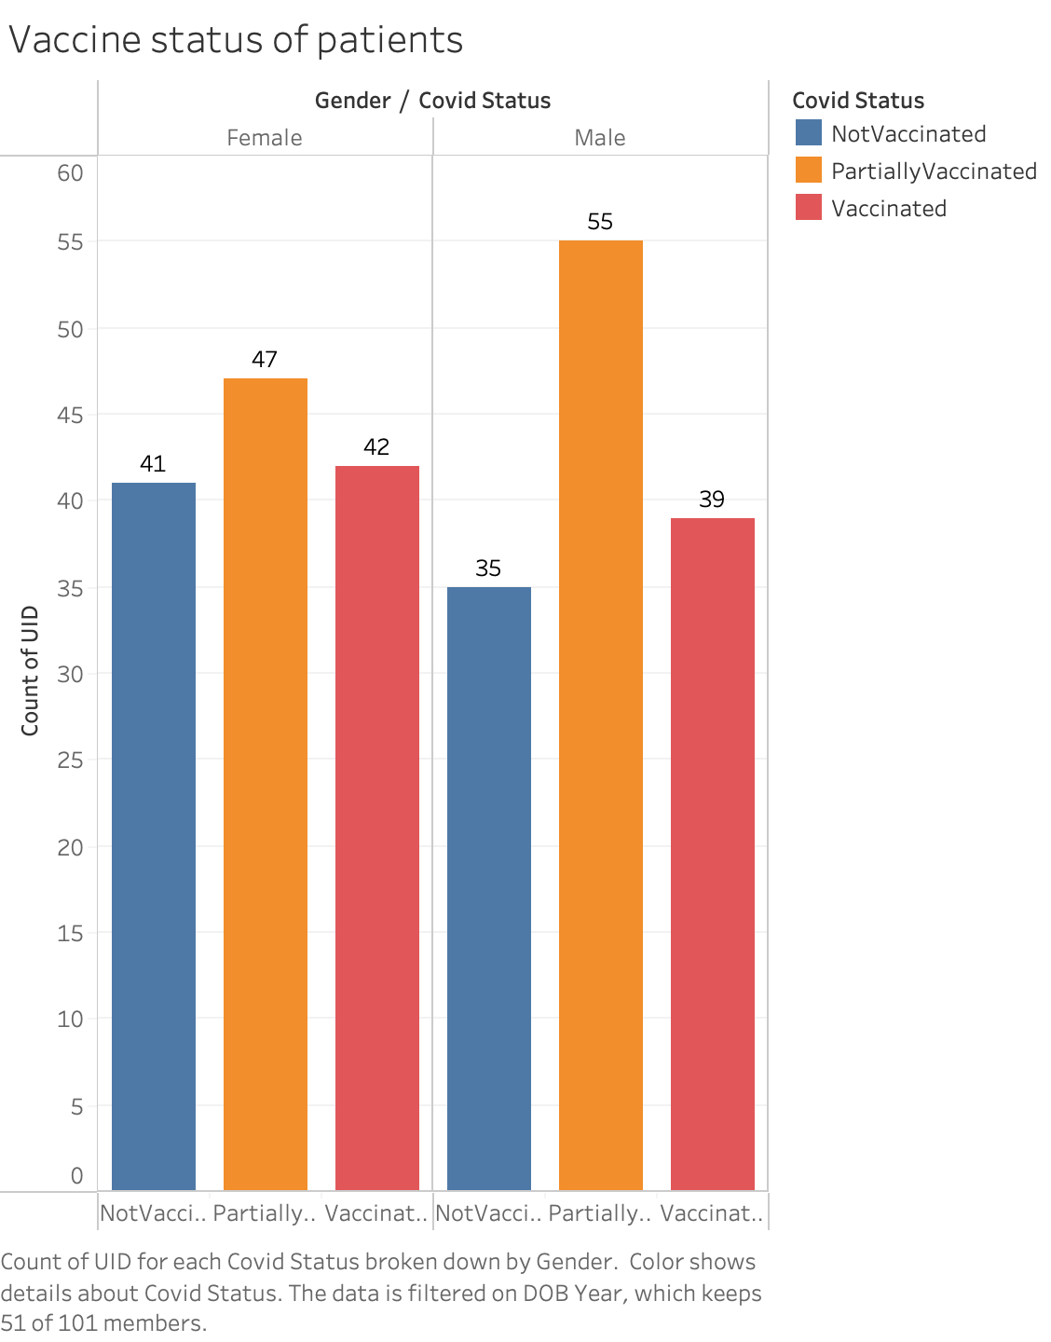
Data Visualization

Slide 13
Three C's
Collector: In the context of the Hospital Management System, collectors could be the hospital staff responsible for entering patient information, treatment records, and other relevant data into the system. They may also include external partners such as insurance providers or laboratories that provide data relevant to the hospital's operations.
Custodian: The custodian in the context of the Hospital Management System would be the IT personnel responsible for managing the hospital's data storage and security systems. They would ensure that patient data is stored securely and can be accessed quickly and easily when needed. They would also be responsible for ensuring the accuracy and completeness of the data stored in the system.
Customer/Consumer: In the context of the Hospital Management System, the customer/consumer would be the patients receiving medical care from the hospital. The system would allow patients to access their medical records, schedule appointments, and communicate with doctors and staff. By understanding the needs and preferences of its patients, the hospital can improve the quality of care it provides and enhance patient satisfaction.

Slide 14
Information Products (IP)
Information Product ​ | Definition ​
Electronic Health Records (EHRs)​ ​ | EHRs are digital versions of patient health records that can be accessed and updated by authorized healthcare providers. EHRs can be used to view patient medical history, track medications, and monitor vital signs. ​
Patient Portals​ | Patient portals are online platforms that allow patients to access their medical records, schedule appointments, and communicate with healthcare providers. Patients can view test results, request prescription refills, and ask questions about their care. ​ ​

Slide 15
Electronic Health Records (EHRs)​
Patient Demographics​
Medical History​
Medication Management​
Clinical Notes​
Lab Results​
Care Plans​
Imaging Reports​
Immunization Records​
Consent and Authorization Forms​
Health Information Exchange (HIE) Data​
Patient Portals​​
Personal Demographics​​
Medical History​​
Appointments​​
Test Results​​
Medication Management​​
Communication​​
Billing and Payments​​
Education and Resources​​
Telehealth​​
Health Tracking​​

Slide 16
4 Principles of IP
Data Governance: Effective data governance is critical for managing information products in a hospital management system. This involves establishing policies and procedures for data management, ensuring data quality and accuracy, and managing data security and privacy.
User-centered Design: Information products must be designed with the end-user in mind. This means involving stakeholders in the design process, conducting user testing, and prioritizing user needs and preferences. The goal is to create products that are easy to use and meet the needs of all users, including patients, healthcare providers, and hospital staff.
Agile Development: Agile development is an iterative approach to product development that involves continuous testing and feedback. This approach allows for rapid development and testing of new features and functionality, ensuring that information products remain relevant and effective over time.
Continuous Improvement: Information products must be continuously improved to remain effective and relevant. This involves monitoring performance metrics, analyzing user feedback, and making updates and enhancements based on these insights. By continuously improving information products, hospitals can ensure that they are providing the best possible care to patients while maximizing operational efficiency.

Slide 17
Data Flow:
The data flow for a healthcare management system website can involve several components, including the user interface, application layer, database layer, and backend systems
User Interface: The user interface is the front-end layer of the website where users interact with the system. This layer typically includes web pages and forms that allow users to input data, access information, and interact with the system.
Application Layer: The application layer sits between the user interface and the database layer and manages the flow of data between the two layers. This layer includes the business logic and application programming interfaces (APIs) that enable the website to interact with the database layer and other backend systems.
Database Layer: The database layer stores and manages the data for the healthcare management system. This layer typically includes a relational database management system (RDBMS) and associated database schema that define the structure of the data.
Backend Systems: The backend systems may include other systems and applications that integrate with the healthcare management system, such as electronic medical record (EMR) systems, billing systems, and supply chain management systems. Data from these systems may flow into and out of the healthcare management system through the application layer and database layer.

Slide 18
Potential Problems in Data Quality
Human Error while entering data: One of the potential problems with data quality is human error during data entry. This can include errors in spelling, typing mistakes, or incorrect data values entered into the system. These errors can result in inaccurate patient information, which can negatively impact patient care and treatment. For example, if a patient's allergy information is entered incorrectly, it could lead to the administration of the wrong medication and potentially harmful consequences.
Security concerns because of confidential patient information: Another potential problem with data quality is security concerns due to confidential patient information. Hospital management systems contain sensitive information such as medical history, test results, and personal information. If this information is not secured properly, it can result in data breaches and violations of patient privacy. This can have significant legal and ethical implications for hospitals, damaging their reputation and undermining patient trust.
Volume of data - Multiple entries: The volume of data and multiple entries can lead to data quality problems. Hospital management systems generate vast amounts of data, and if there are multiple entries for the same patient or procedure, it can lead to inconsistencies and inaccuracies in the data. This can make it difficult for healthcare providers to access accurate patient information and make informed decisions about patient care.

Slide 19

Conclusion
To conclude, we have discussed the various aspects of a healthcare management system, including its features, benefits, potential challenges, and strategies for development and implementation. We have explored how a hospital management system can improve patient care, increase operational efficiency, and maximize financial performance. We have also discussed the potential problems with data quality and security, and how hospitals can mitigate these issues through data quality control measures and security protocols.
Overall, a healthcare management system is an essential tool for hospitals and healthcare providers looking to deliver high-quality patient care and streamline their operations. By leveraging the latest technologies, such as artificial intelligence and machine learning, hospitals can gain valuable insights into patient care delivery and optimize their resources to improve patient outcomes and maximize financial performance.
As we move forward in the ever-evolving landscape of healthcare, it is important for hospitals to stay on top of the latest developments and innovations in healthcare management systems. By prioritizing the user experience, continuous improvement, and data governance, hospitals can create a healthcare management system that meets the needs of all stakeholders, including hospital administrators, healthcare providers, and patients.
This Photo by Unknown author is licensed under CC BY-ND.

Slide 20
Future Scope/Lessons
Customization for hospitals/healthcare providers: Do more research to understand the specific needs of the hospital or healthcare provider. This can involve identifying the key processes that the system will need to support, such as patient admissions, discharge, and transfers, managing medical records, managing billing and insurance claims, scheduling appointments, and managing inventory.
Improve UI: Streamlining User Interface, adding new features and modules. The user interface (UI) is the primary means of interaction between the user and the system. A well-designed UI can improve the user experience and increase productivity. Thus, updating the UI with a more user-friendly design or simplifying complex processes can improve the system's performance.
Add new features or modules: We plan to incorporate more machine-learning algorithms to analyze data and release our systems in more platforms to help hospitals/healthcare providers receive more insights.
Provide Training and Support: We will update manuals/guides for our system regularly for patients and provide regular training/workshops on how to use the system for hospital/healthcare providers. Effective training and support can help users understand the system's functionality and improve their usage. Regular training sessions, workshops, and support resources can help to optimize the use of our system.

Slide 21
Thank you
Thank you for paying attention
Please feel free to ask any questions

